Slide 1

RCB – IPL Strategy
Submitted By – Akshay Sopori

Slide 2

History of IPL
The Indian Premier League (IPL) is a professional Twenty20 cricket league in India, which began in 2008.
2008: The Inaugural Season
Launch: The IPL was established by the Board of Control for Cricket in India (BCCI) under the chairmanship of Lalit Modi.
Teams: The initial season featured eight franchises: Mumbai Indians, Chennai Super Kings, Royal Challengers Bangalore, Kolkata Knight Riders, Rajasthan Royals, Kings XI Punjab, Delhi Daredevils, and Deccan Chargers.
Winner: Rajasthan Royals, led by Shane Warne, won the inaugural IPL by defeating Chennai Super Kings in the final.
2009: The South Africa Edition
Shift in Venue: Due to the general elections in India, the IPL was moved to South Africa.
Winner: Deccan Chargers, led by Adam Gilchrist, won their first and only IPL title by defeating Royal Challengers Bangalore in the final.

Slide 3
History of IPL
2010: The Return to India
Milestones: IPL returned to India with matches held across multiple cities.
Winner: Chennai Super Kings, under the captaincy of MS Dhoni, won their first IPL title by defeating the Mumbai Indians in the final.
2011: Expansion and Changes
New Teams: The league expanded to 10 teams with the addition of Pune Warriors India and Kochi Tuskers Kerala.
Winner: Chennai Super Kings retained their title by defeating Royal Challengers Bangalore in the final, becoming the first team to win back-to-back IPL titles.
Notable Event: Kochi Tuskers Kerala was terminated after just one season due to contractual issues.
2012: Return to 8 Teams
Contraction: The league was reduced back to 9 teams after the termination of Kochi Tuskers Kerala.
Winner: Kolkata Knight Riders, led by Gautam Gambhir, won their first IPL title by defeating Chennai Super Kings in the final.

Slide 4

History of RCB
2008: Inception and Early Struggles
Launch: Royal Challengers Bangalore (RCB) was founded in 2008, owned by Vijay Mallya's United Spirits.
Captain: Rahul Dravid was the first captain of the team.
Performance: RCB had a tough inaugural season, finishing 7th out of 8 teams.
2009: The Turnaround
Captain: Kevin Pietersen was appointed captain, but after leaving for international duty, Anil Kumble took over.
Performance: RCB made a remarkable turnaround, finishing as runners-up after losing to Deccan Chargers in the final.
2010: Consistent Performances
Captain: Anil Kumble continued as captain.
Performance: RCB finished 3rd, reaching the semi-finals but losing to Mumbai Indians.

Slide 5
History of RCB
2012: Building a Strong Core
Performance: RCB finished 5th, missing out on the playoffs by a narrow margin. Chris Gayle continued his phenomenal form, winning the Orange Cap for the most runs.
2013: Rise of Virat Kohli
Captain: Virat Kohli was appointed as the full-time captain.
Performance: Despite Kohli's and Gayle's performances, RCB finished 5th, failing to make it to the playoffs.
2015: Playoff Return
Performance: RCB finished 3rd, making it to the playoffs but losing to Chennai Super Kings in the second qualifier.
2016: The Virat Kohli Show
Record-Breaking Season: Virat Kohli had an extraordinary season, scoring 973 runs, the most by any player in a single IPL season, including four centuries.
Performance: RCB finished as runners-up, losing to Sunrisers Hyderabad in the final. The team was often criticized for relying heavily on its batting, while the bowling was considered a weak point.

Slide 6
Problem Statements
Suggest few strategies before going into the auction.
Suggest few Players which RCB can look for in the auction.
Analyze the batting averages, bowling averages of players and past performances which can be taken into consideration.
Analyze the home performances vs the away performances of RCB.
Analyze the reasons why RCB is not able to perform well.
Analyze the roles that needs to be focused.

Slide 7
Overview of Data
Raw Data has in total 22 tables.
Description: Contains tables such as ball_by_ball, matches, batsman_scored, wicket_taken, player, venue, bowling style, batting_style, extra_runs, season, role, city, country, team, out_type, extra_type, umpire, toss_decision, player_match, outcome

Slide 8
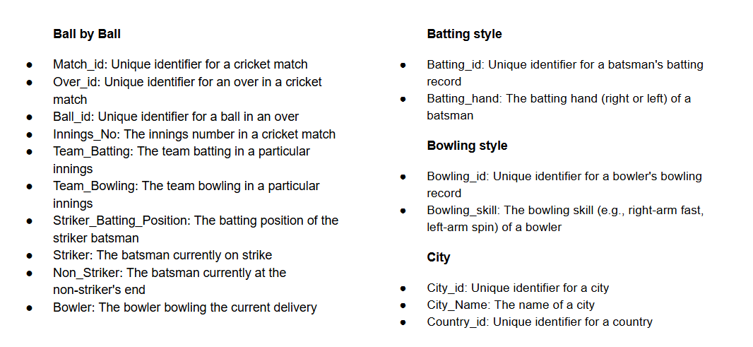
Overview of Tables

Slide 9
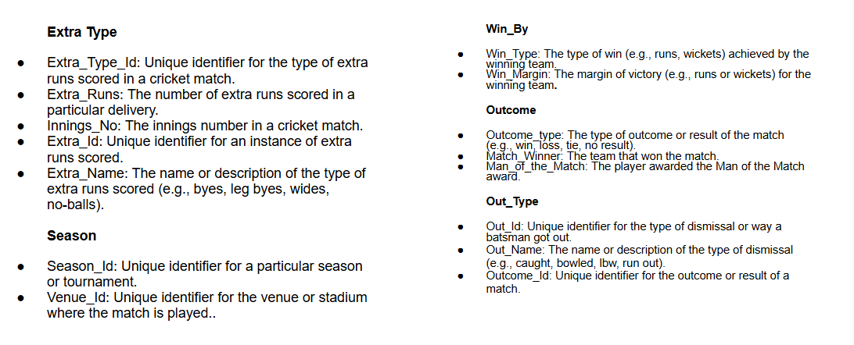
Overview of Tables

Slide 10
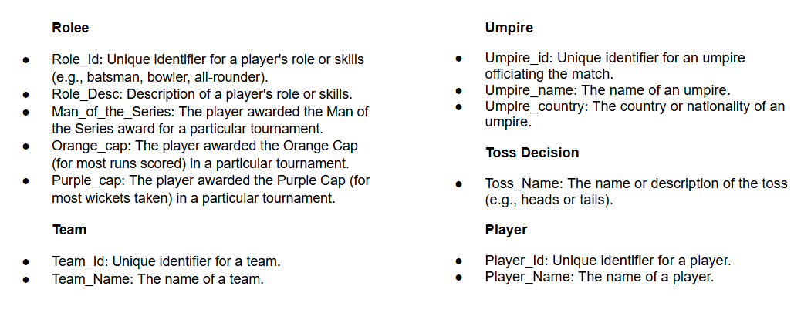
Overview of Tables

Slide 11
Strategies to consider before going into auction
Points considered for suggesting players:
More number of boundaries = More runs scored and less deliveries taken
Consistency= Overall team growth and good performance
If any player has consistently performed well in the past seasons he can be considered for the next season.
Also team can focus on young talents which can be groomed into future stars.
Team can look for players who can perform with both the bat and the ball

Slide 12
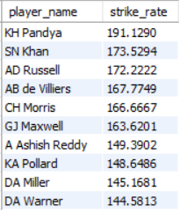
Players to consider for the auction
After analysing data wrt to the points mentioned, the below players are best suited for the team
Based on their strike rate

Slide 13
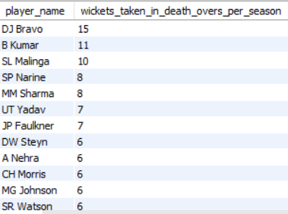
Players to consider for the auction
After analysing data wrt to the points mentioned, the below players are best suited for the team
Based on their wicket taking ability in death overs

Slide 14
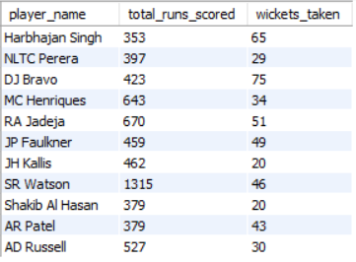
Players to consider for the auction
After analysing data wrt to the points mentioned, the below players are best suited for the team
Based on their all-round performances in previous 4 seasons:

Slide 15
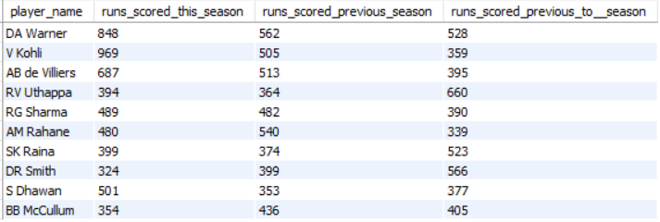
Batting performances in the past seasons
Batting performances in previous seasons:

Slide 16
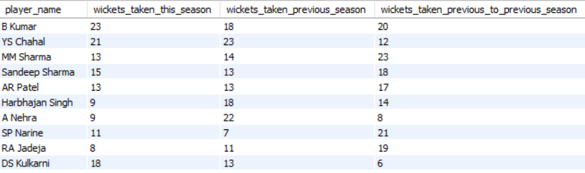
Bowling performances in the past seasons
Bowling performances in previous seasons:

Slide 17
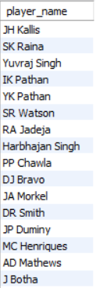
All-round performances in the past seasons
All-round performances in previous seasons:

Slide 18
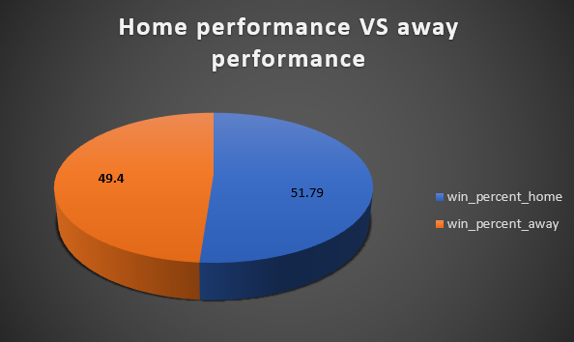
Home performance vs the away performance

Slide 19
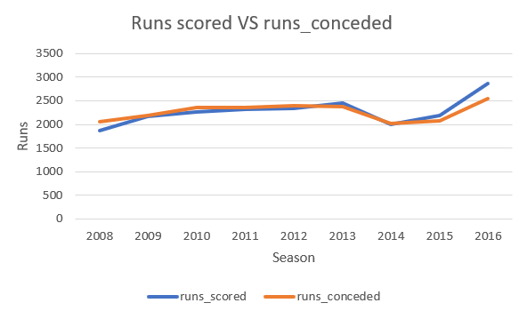
Reasons why team is not performing well
Clearly the runs conceded by the RCB team is higher than the runs scored by the team.
The team should invest in some good quality bowlers.

Slide 20
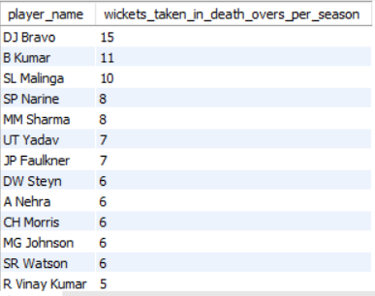
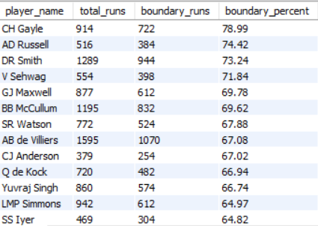
Roles that needs to be focused on
The team needs to focus on some good quality bowlers who can take wickets in the death overs which will eventually result in less number of runs scored.
Also, the team can look for power hitters who can hit boundaries in the later part of the innings.
Death Over bowlers Boundary hitters

Slide 21
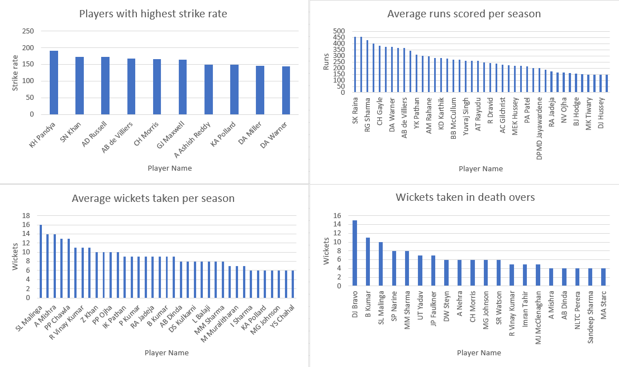
Dashboard & Visualisations

Slide 22
Methodology
Used SQL workbench for data analysis, cleaning, pre-processing, and used excel for the visualization.
Leveraged SQL functions and advanced functions such as Subqueries, CTEs and Window functions.
Steps included data cleaning, pre-processing, enrichment, and enhancement.
Analyzed data using CTEs and conducted analysis.
Visualized data with charts and graphs by exporting the query results into excel

Slide 23
Insights
Batsman to look for:
Recommendation: Batsman to look for in the next auction are R Sharma, D Warner, B Mcculum, A Rayudu & M Hussey and D Miller.
Justification: These Players have consistently performed well over the previous seasons and are most likely to be top performers in the coming seasons.
Bowlers to look for:
Recommendation: Bowlers to look for in the next auction are L Malinga, P Chawla, P Kumar, DJ Bravo, S Narine and B Kumar.
Justification: These players have been on the wicket takers chart and also have performed reasonably well in the death overs.
Allrounders to look for:
Recommendation: Allrounders to look for are S Raina, K Pollard, K Pandya, Yuvraj Singh, G Maxwell.
Justification: As per the analysis it was clearly visible that the above players are good with both bat and the ball and can also do power hitting at the later overs of the game.

Slide 24
Conclusions
The analysis reveals valuable insights for team management before going into the next auction, guiding strategic decisions for improvement. Key findings include:
Identification of players with consistency and high potential of growth.
Understanding conditions and the impact of powerplay & death overs.
Recommendations for players who can perform with both bat and the ball to enhance team performance and competitiveness.
Visualizations provide clear insights into past performance and overall consistency.
This analysis underscores the importance of data-driven decision-making in the team management, enabling team to perform well in the upcoming seasons.

Slide 25

THANK YOU

